Slide 1
People
Analytic -
Job satifaction
Aurthor
Fuad Hasyim

Slide 2
Agenda
Dataset (01)
Prepocessing (02)
Data Exploration (03)
Job satisfaction by category (04)
Numeric Corelation (05)
Result (06)

Slide 3
Deskripsi dataset
1. Kolom
2. Variabel target
Berisi tentang informasi demografis, karakteristik pekerjaan, kondisi kerja, kebiasaan sehari-hari, serta tingkat kepuasan kerja (job satisfaction).
Tujuannya adalah untuk menganalisis faktor-faktor yang berhubungan dengan job satisfaction karyawan.
emp_id, gender, age, dept, job_level, wlb, work_env, workload, stress, sleep_hours, training_hours_per_year, job_satisfaction
job_satisfaction (1–5)
3. Variabel faktor:
workload, stress, sleep_hours, dept, job_level, dll.

Slide 4
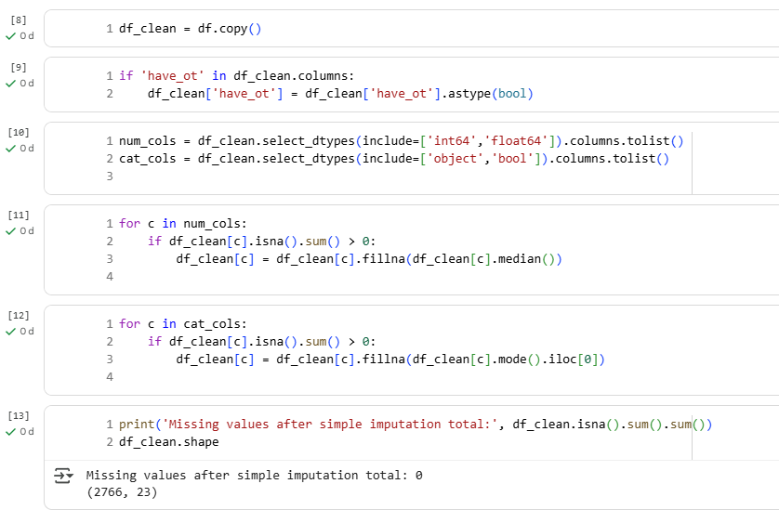
Preprocessing
Cheking Missing Value
The data does not have missing values ​​so we can proceed to the next stage

Slide 5
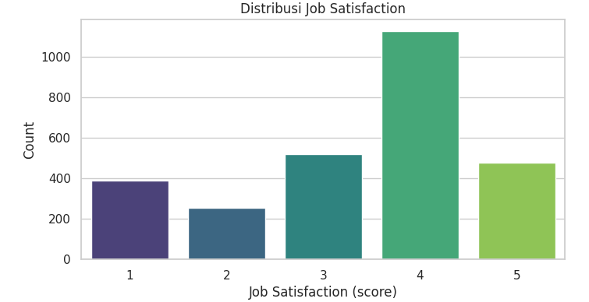
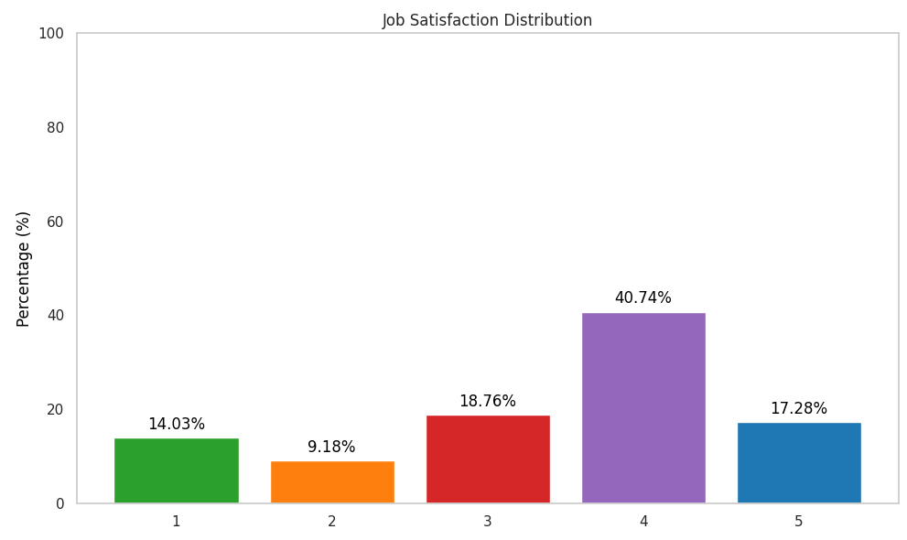
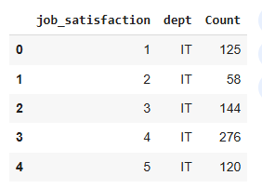
Data Exploration
Job Satisfaction
Percentage of job satisafaction
Most of the ratings 1 - 5
The highest rating from the job satisfaction survey is rating 4
The highest percentage rating from the job satisfaction survey was rating 4 at 40.74%.
Most of the ratings 1 - 5 are from the IT department

Slide 6
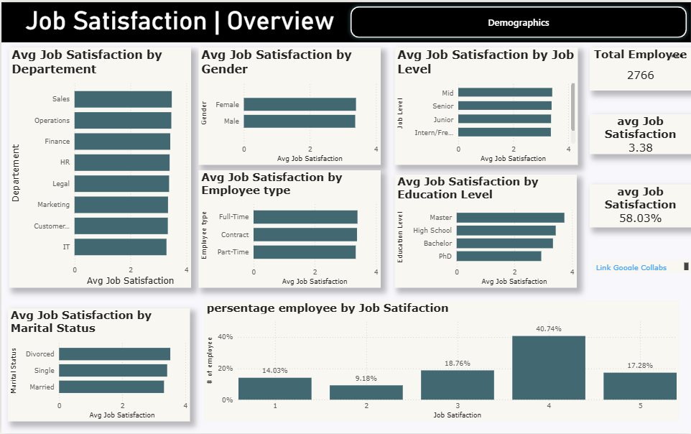

Slide 7
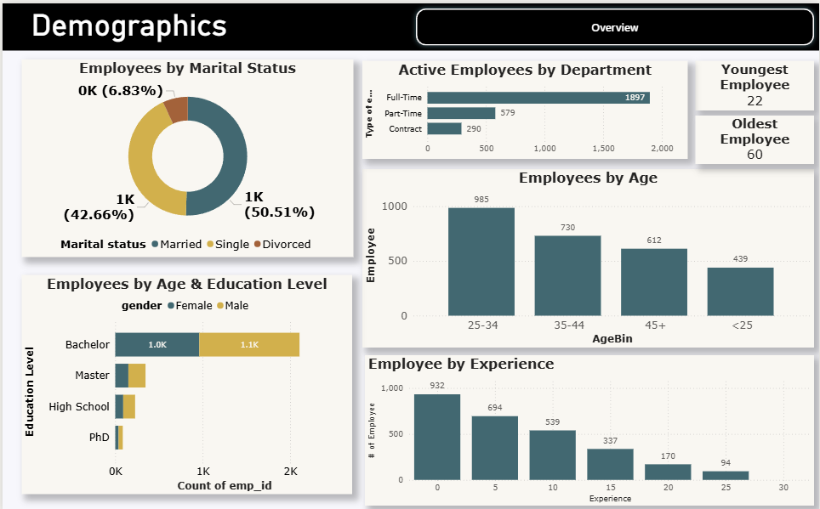

Slide 8
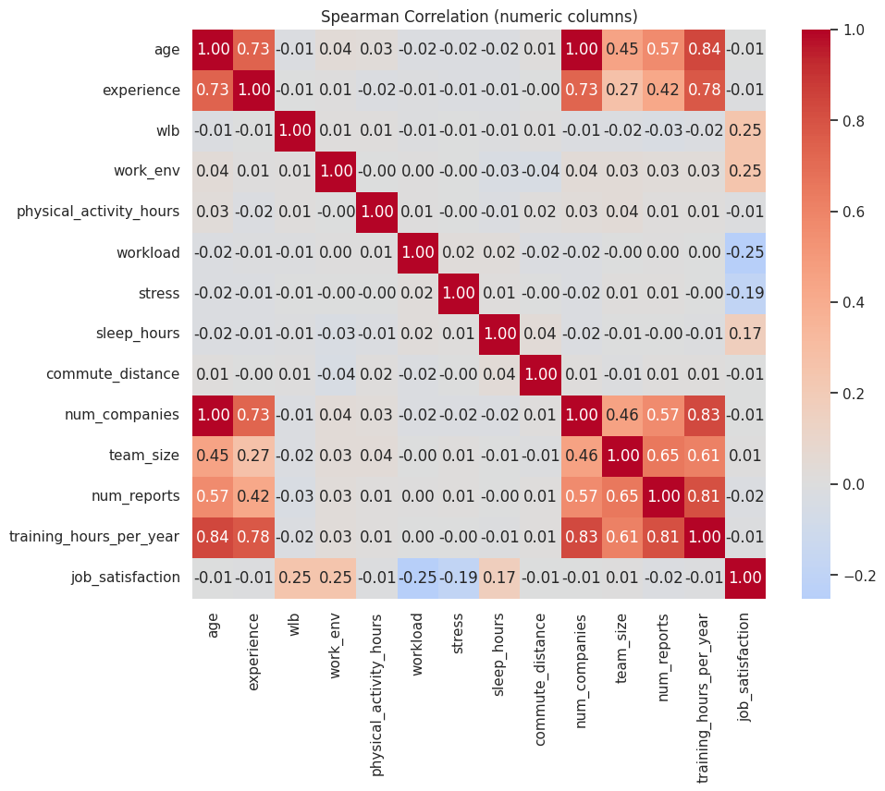
Job satisfaction vs WLB (0.25) & Work_env (0.25) This means that job satisfaction is somewhat influenced by work-life balance and work environment, although the correlation is not very high.
Job satisfaction vs Workload (-0.25) High workload tends to lower job satisfaction.
Job satisfaction vs Stress (-0.19) Higher stress also slightly lowers job satisfaction.
The conclusion of the initial hypothesis about job satisfaction is that it is most influenced by workload factors (negative), stress (negative), work-life balance (positive), and work environment (positive).
Numeric Corelation
Correlation related to Job satisfaction

Slide 9
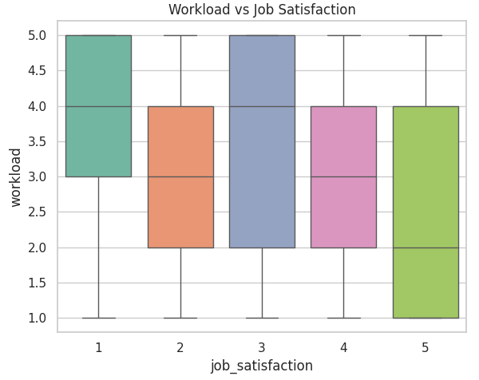
Result
1. Workload vs. Job Satisfaction
Low job satisfaction (1–2) → higher median workload (around 3–4).
High job satisfaction (4–5) → lower median workload (around 2).
A trend is observed: the higher the job satisfaction, the lower the perceived workload.
Workload varies considerably across all satisfaction levels, but there is a pattern of decreasing average workload at higher job satisfaction levels.
High workload tends to decrease job satisfaction.

Slide 10
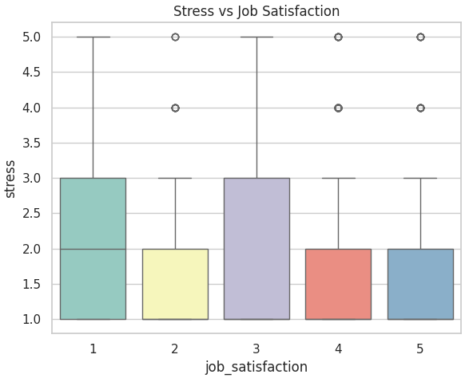
Result
2. Stress vs. Job Vacation
Low job satisfaction (1–2) → higher median stress (2–3).
High job satisfaction (4–5) → lower median stress (around 1–2).
There are several high-stress outliers (4–5) at all levels of job satisfaction, meaning that although the majority of those with high satisfaction have low stress, there are still individuals who are stressed even though they are satisfied with their jobs.
The lower the stress, the higher the job satisfaction.

Slide 11
Thank you

